Slide 1
CHAPTER TWO 2. Approaches to Ethics
Ethics, also known as moral philosophy, is a branch of philosophy that addresses questions about morality that is, concepts such as good and evil, right and wrong, virtue and vice, justice, etc.
The field of ethics (or moral philosophy) involves systematizing, defending, and recommending concepts of right and wrong behavior.
The three major approaches; Non-normative, Normative and Applied ethics)
2.1 Metaethics(Non-normative Ethics)
The term “meta” means after or beyond, and, consequently, the notion of metaethics involves a removed, or bird’s eye view of the entire project of ethics.

Slide 2
Metaethics is the study of the origin and meaning of ethical concepts.
When compared to normative ethics and applied ethics, the field of metaethics is the least precisely defined area of moral philosophy.
It covers issues from moral semantics(Meanings of words) to moral epistemology. Two issues, though, are prominent:
(1)Metaphysical issues concerning whether morality exists independently of humans, and
(2)Psychological issues concerning the underlying mental basis of our moral judgments and conduct.

Slide 3
Meta-ethics, rather, concerned with questions about the following:
Meaning: what is the semantic function of moral discourse? Is the function of moral discourse to state facts, or does it have some other non-fact-stating role?
Metaphysics: do moral facts (or properties) exist? If so, what are they like? Are they identical or reducible to some other type of fact (or property) or are they irreducible and sui generis?
Epistemology and justification: is there such a thing as moral knowledge? How can we know whether our moral judgments are true or false? How can we ever justify our claims to moral knowledge?
Phenomenology: how are moral qualities represented in the experience of an agent making a moral judgement? Do they appear to be 'out there' in the world?
Is the study of the development of human consciousness and self awareness.

Slide 4
2.1.1. Metaphysical Issues: Objectivism and Relativism
Metaphysics is the study of the kinds of things that exist in the universe.
Some things in the universe are made of physical stuff, such as rocks; and perhaps other things are nonphysical in nature, such as thoughts, spirits, and gods.
The metaphysical component of metaethics involves discovering specifically whether moral values are eternal truths that exist in a spirit-like realm, or simply human conventions.
There are two general directions, other-worldly and this-worldly

Slide 5
A. Objectivism (Universalism)
Proponents of the other-worldly view typically hold that moral values are objective in the sense that they exist in a spirit-like realm beyond subjective human conventions.
They also hold that they are absolute, or eternal, in that they never change, and also that they are universal insofar as they apply to all rational creatures around the world and throughout time.
The most dramatic example of this view is Plato, who was mathematical relations, such as 1+1=2, they seem to be timeless concepts that never change, and apply everywhere in the universe.

Slide 6
B. Relativism (Subjectivism)
The second and more this-worldly approach to the metaphysical denies the objective status of moral values.
Technically, skeptics did not reject moral values themselves, but only denied that values exist as spirit-like objects, or as divine commands in the mind of God.
Moral values, they argued, are strictly human inventions, a position that has since been called moral relativism.
There are two distinct forms of moral relativism.
The first is individual relativism, which holds that individual people create their own moral standards.
The second is cultural relativism which maintains that morality is grounded in the approval of one’s society

Slide 7
Meta-ethics concerns-in metaphysics, epistemology, phenomenology and moral psychology, as well as in semantics and the theory of meaning.
Positions in meta-ethics can be defined in terms of the answers they give to these sorts of question.
Some examples of meta-ethical theories are Cognitivism, non-cognitivism, Error theory, More realism
Cognitivism think that moral judgments are capable of being true or false.
Non-cognitivism think that moral judgments express states such as emotions or desires.
Desires and emotions are not truth-apt. So moral judgments are not capable of being true or false.

Slide 8
Strong Cognitivism: Naturalism
A strong cognitivism theory is one which holds that moral judgments
(a) are apt(appropriate) for evaluation in terms of truth and falsity, and
(b)can be the upshot(final result) of cognitively accessing the facts which render them true.
Strong cognitivist theories can be either naturalist or non-naturalist.
According to a naturalism, a moral judgments is rendered true or false by a natural state of affairs, and a true moral judgments affords us access.
Strong Cognitivism: Non-Naturalism
Non-naturalism think that moral properties(special quality) are not identical to or reducible to natural properties.
They are irreducible and sui generis(unique).

Slide 9
Non-Cognitivism
Non-cognitivists deny that moral judgements are even apt to be true or false.
They disagree with both weak and strong cognitivism.
We shall look at a number of arguments which the non-cognitivist uses against cognitivism. An example of such an argument is the argument from moral psychology.
Suppose that moral judgements can express beliefs, as the cognitivist claims.
Being motivated to do something or to pursue a course of action is always a matter of having a belief and a desire.

Slide 10
As this theory the property of moral goodness is non-natural, simple, and unanalyzable
Non-naturalist theories are moral realists.
They think that really moral facts and moral properties, and the existence of these moral facts and instantiation of these moral properties are constitutively independent of human opinion.
Strong Cognitivism without Moral Realism: Mackie’s 'Error-Theory’
John Mackie has argued that moral judgments are apt to be true or false, and that moral judgments, if true, it would afford us cognitive access to moral facts and moral judgments are in fact always false.

Slide 11
Because, simply there are no moral facts or properties in the world to render moral judgments true: hence, we have no epistemological account of how we could access such facts and properties.
He concludes that there are no moral properties or moral facts, so that (positive, atomic) moral judgments are uniformly false: our moral thinking involves us in a radical error.
Mackie denies that moral facts or properties, he is not a moral realist, but a moral antirealist.

Slide 12
Weak Cognitivism about Morals without Moral Realism: 'Best Opinion' Theories
A weak cognitivist theory moral judgments are apt for evaluation in terms of truth and falsity, but cannot be the upshot of cognitive access to moral properties and states of affairs.
Weak cognitivism thus agrees with strong cognitivism on, but disagrees on moral judgments it believe that our best judgements about morals determine the extensions of moral predicates, rather some faculty which tracks, detects or cognitively accesses facts about the instantiation of moral properties.

Slide 13
Non-cognitivists deny that moral judgements are even apt to be true or false.
Non-cognitivists thus disagree with both weak and strong cognitivism.
Non-cognitivists think that moral judgments express such as emotions or desires.
We shall look at three versions of non-cognitivism which give different answers to this question:
J. Ayer's emotivism (1936), according to which moral judgements express emotions, or sentiments of approval or disapproval;
Simon Blackburn's quasi-realism (1984), according to which moral judgements express our dispositions to form sentiments of approval or disapproval; and
Allan Gibbard's norm-expressivism (1990), according to which our moral judgements express our acceptance of norms.

Slide 14
Number of arguments non-cognitivist that against cognitivism from moral psychology as follows.
Internalism and Externalism, Humeanism and Anti- Humeanism
One of the premises in the argument from moral psychology claim that an internal and necessary connection b/n making a moral judgments and motivated to act prescribed by that judgment is known as internalism.
Because it is an internal or conceptual connection between moral judgment and motivation.
The difference is cognitivist philosophers respond to the argument from moral psychology by denying internalism.
The premises in an argument connection between judgement and motivation is only external and contingent (dependent on) is known as externalism.

Slide 15
Other cognitivist philosophers respond to the argument from moral psychology by denying another premise of the argument, the claim that motivation always involves the presence of both beliefs and desires (this premise is known as the Humean theory of motivation, since it received a classic exposition by Hume).
McDowell and Wiggins advance an anti-Humean theory of motivation, according to which beliefs themselves can be intrinsically motivating.

Slide 16
Generally, Meta-ethics:
Examines the meaning of moral terms and concepts and the relationships between these concepts.
Explores where moral values, such as ‘personhood’ and ‘autonomy’, come from.
Considers the difference between moral values and other kinds of values.
Examines the way in which moral claims are justified.

Slide 17
2.2 Applied Ethics
Applied ethics is the branch of ethics which consists of the analysis of specific, controversial moral issues such as abortion, animal rights, or euthanasia.
In recent years applied ethical issues have been subdivided into convenient groups (Professional ethics) such as medical ethics, business ethics, environmental ethics, and sexual ethics.
Generally speaking, two features are necessary for an issue to be considered an “applied ethical issue.” First, the issue needs to be controversial in the sense that there are significant groups of people both for and against the issue at hand.

Slide 18
The second requirement for in issue to be an applied ethical issue is that it must be a distinctly moral issue.
On any given day, the media presents us with an array of sensitive issues such as:
affirmative action policies,
gays in the military,
involuntary commitment of the mentally impaired,
capitalistic versus socialistic business practices,
public versus private health care systems, or
energy conservation.

Slide 19
2.3. Normative Ethics
Normative ethics involves arriving at moral standards that regulate right and wrong conduct. In a sense, it is a search for an ideal litmus test of proper behavior.
The Golden Rule is a classic example of a normative principle: We should do to others what we would want others to do to us.
Since I do not want my neighbor to steal my car, then it is wrong for me to steal her car.
Since I would want people to feed me if I was starving, then I should help feed starving people.

Slide 20
The ultimate concern of the normative theory of obligation is to guide us in the making of decisions and judgments about actions in particular situations.
Offers theories or accounts of the best way to live.
These theories evaluate actions in a systematic way, i.e., they may focus on outcomes or duties or motivation as a means of justifying human conduct.

Slide 21
It includes ethical theories or approaches such as
teleological,
deontology,
virtue ethics,
principlism,
narrative ethics and feminist ethics.
Normative ethics poses questions of the following kind:
Are there general principles or rules that we could follow which distinguish between right and wrong? Or:
Are there virtues and/or relationships that we can nurture, in order to behave well?

Slide 22
2.3.1 Teleological Ethics (Consequentialism)
Consequentialist theories are sometimes called teleological theories, from the Greek word telos, or end, since the end result of the action is the sole determining factor of its morality.
According to consequentialism, correct moral conduct is determined solely by a cost-benefit analysis of an action’s consequences:
Consequentialism: An action is morally right if the consequences of that action are more favorable than unfavorable
It is referred as “the end justifies the means”.
It believes in purpose, ends or goals of an action, it stress that the consequences of an action determines the morality or immorality of a given action.
Which means an action is judged as right or wrong, moral or immoral depending on what happens because of it.
One may have the best intention or follow the highest moral principles but if the result, moral act is harmful, or bad it must be judged as morally or ethically wrong act.

Slide 23
Thus, an act is right if and only if it or the rule under which it falls produces, will probably produce, or is intended to produce at least as great a balance of good over evil as any available alternative; an act is wrong if and only if it does not do so.
An act ought to be done if and only if it or the rule under which it falls produces, will probably produce, or is intended to produce a greater balance of good over evil than any available alternative.
Three subdivisions of consequentialism emerge:
• Ethical Egoism: an action is morally right if the consequences of that action are more favorable than unfavorable only to the agent performing the action.
• Ethical Altruism: an action is morally right if the consequences of that action are more favorable than unfavorable to everyone except the agent.
• Utilitarianism: an action is morally right if the consequences of that action are more favorable than unfavorable to everyone.

Slide 24
A. Egoism
The word “Egoism’ comes from Greek word ‘ego’, ‘I’ and therefore, literally, ‘I’ism’. The central concern of egoism is the ‘self’ as the beginning and of all consideration.
Generally, in egoism, self-interest is the nucleus or central for every ethical action or decision.
In other words, what is right and wrong is to be decided on the basis of the interest of every egoist individual.
On the basis of the above two views, egoism can be taken two forms,
• The psychological egoism
• The ethical egoism

Slide 25
A. The psychological Egoism
The psychological Egoism is motivated out of self-interests and aims at self satisfaction.
It is also doctrine about human nature, claiming that everyone by nature motivated primarily his or her own interests.
According to psychological egoism, people always seeks one’s own advantage or self interest, or always does what he thinks will give him the greatest balance of good over evil.
This means also that “self-love’ is the only basic “principle” in human nature.
The ‘ego-satisfaction” is the final aim of all activity or that” the pleasure principle”.

Slide 26
B. Ethical Egoism
Ethical egoism maintains that each of us should look at only at the consequences that affect us.
If views that each person ought to perform those actions that contribute most to his or her own self-interest.
Ethical egoism is a normative theory.
It is a theory about what ought to do, how we ought to act as with psychological egoism.

Slide 27
B. Utilitarianism
Utilitarianism is a universal teleological system it calls for the maximization of goodness in society that is, the greatest goodness for the greatest number and not merely the good of the agent.
Classical utilitarianism
For Epicurus (342–270 BCE), who stated that “pleasure’’ is the goal that nature has ordained for us; it is also the standard by which we judge everything good.”
According to this view, rightness and wrongness are determined by pleasure or pain that something produces.

Slide 28
Jeremy Bentham and John Stuart Mill
Jeremy Bentham: Quantity over Quality
There are two main features of utilitarianism, both of which Bentham articulated:
The consequentialist principle (or its teleological aspect): states that the rightness or wrongness of an act is determined by the goodness or badness of the results that flow from it.
It is the end, not the means that counts; the end justifies the means. and
The utility principle (or its hedonic aspect): states that the only thing that is good in itself is some specific type of state (for example, pleasure, happiness, welfare).

Slide 29
Hedonistic utilitarianism views pleasure as the sole good and pain as the only evil.
An act is right if it either brings about more pleasure than pain or prevents pain, and an act is wrong if it either brings about more pain than pleasure or prevents pleasure from occurring.
Bentham invented a scheme for measuring pleasure and pain that he called the hedonic calculus:
The quantitative score for any pleasure or pain experience is obtained by summing the seven aspects of a pleasurable or painful experience:
Intensity:
Duration:
Certainty:
Nearness:
Fruitfulness:
Purity:
Extent:

Slide 30
There is something appealing about Bentham’s utilitarianism.
It is simple in that there is only one principle to apply:Maximize pleasure and minimize suffering.
It is commonsensical in that we think that morality really is about reducing suffering and promoting benevolence. It is scientific:
Simply make quantitative measurements and apply the principle impartially, giving no special treatment to ourselves or to anyone else because of race, gender, personal relationship, or religion.

Slide 31
John Stuart Mill: Quality over Quantity
His version of the theory is often called eudaimonistic utilitarianism (from the Greek eudaimonia, meaning “happiness”).
He defines happiness in terms of certain types of higher-order pleasures or satisfactions such as intellectual, aesthetic, and social enjoyments, as well as in terms of minimal suffering.
For Mill, there are two types of pleasures.
The lower, or elementary, include eating, drinking, sexuality, resting, and sensuous titillation.
The higher include high culture, scientific knowledge, intellectuality, and creativity.
Although the lower pleasures are more intensely gratifying, they also lead to pain when overindulged in.
The higher pleasures tend to be more long term, continuous, and gradual.

Slide 32
Mill argued that the higher, or more refined, pleasures are superior to the lower ones:
“It is better to be a human being dissatisfied than a pig satisfied; better to be Socrates dissatisfied than a fool satisfied.”
Humans are the kind of creatures who require more to be truly happy.
They want the lower pleasures, but they also want deep friendship, intellectual ability, culture, the ability to create and appreciate art, knowledge, and wisdom.
But what does it mean to speak of better pleasure? The formula he comes up with is this: Happiness … [is] not a life of rapture;
But moments of such, in an existence made up of few and transitory pains, many and various pleasures, with a decided predominance of the active over the passive, and having as the foundation of the whole, not to expect more from life than it is capable of bestowing.

Slide 33
Mill is clearly pushing the boundaries of the concept of “pleasure” by emphasizing higher qualities such as knowledge, intelligence, freedom, friendship, love, and health.
In fact, one might even say that his litmus test for happiness really has little to do with actual pleasure and more to do with a non-hedonic cultivated state of mind.
Act- And Rule-Utilitarianism
There are two classical types of utilitarianism: act- and rule-utilitarianism.
In applying the principle of utility, act-utilitarians, such as Bentham, say that ideally we ought to apply the principle to all of the alternatives open to us at any given moment.
We may define act-utilitarianism in this way:

Slide 34
Act-utilitarianism argues that an act is right if and only if it results in as much good as any available alternative.
One practical problem with act-utilitarianism is that we cannot do the necessary calculations to determine which act is the correct one in each case, for often we must act spontaneously and quickly.
So rules of thumb are of practical importance for example, “In general, don’t lie,” and “keep your promises.”
However, the right act is still that alternative that results in the most utility.
A second problem with act-utilitarianism is that it seems to fly in the face of fundamental intuitions about minimally correct behavior.

Slide 35
The alternative to act-utlitarianism is a view called rule-utilitarianism—elements of which we find in Mill’s theory. Most generally, the position is this:
Rule-utilitarianism: An act is right if and only if it is required by a rule that is itself a member of a set of rules whose acceptance would lead to greater utility for society than any available alternative.
Human beings are rule-following creatures. The act-utilitarian rule, to do the act that maximizes utility, is too general for most purposes.
The Strengths of Utilitarianism
Utilitarianism has three positive features
The first strength of utilitarianism is, it has a single principle and an absolute system answer for every situation that is promote the most utility!
Its second strength is that utilitarianism seems to get to the substance( uniformity) of morality. i.e it has universal principle of morality which had ‘’We should promote human (and possibly animal)’’ flourishing and reduce suffering.

Slide 36
A third strength of utilitarianism is that it is particularly well suited to address the problem of posterity (future).
However, utilitarians believes that one overriding duty:
They strive to preserve scarce natural resources for the betterment of future generations of humans that do not yet exist.
To maximize general happiness.
To ensure the quality of life of future people promises to be positive
If utilitarians are correct, we have an obligation to leave posterity to as good a world as we can through , keeping top soil intact, protecting endangered species, reducing our carbon dioxide emissions, preserving the wilderness, and using technology wisely.

Slide 37
Criticism of Utilitarianism
A. Problems with Formulating Utilitarianism:- The one set of problems occurs in formulation of utilitarianism in two greatest things called happiness and number how we can identifying by formula.
B.The Comparative Consequences Objection:- Another crucial problem with utilitarianism believes that a superhuman ability to look into the future and survey a mind-boggling array of consequences of actions.
Of course, we normally do not know the long-term consequences of our actions because life is too complex and the consequences go on into the indefinite future.

Slide 38
C. The Consistency Objection to Rule-Utilitarianism:-An often-debated question about rule-utilitarianism is logical limits, either become a deontological system or act-utilitarianism. As such, it is an inconsistent theory that offers no truly independent standard for making moral judgments.
D. The No-Rest Objection :- According to utilitarianism, always promises to promote the most utility. But impossible to understand he/she acts fairly sure.
E.The Publicity Objection:- This is precisely the problem with utilitarianism.
Because on the one hand, they were might concern ourselves (own interest) and the other things happiness the greatest number. So, this is contradict the objection of publicity.

Slide 39
F. The Relativism Objection:- Sometimes people accuse rule-utilitarianism being relativistic because it seems to endorse different rules in different societies. So, this fails the universal principle of utilitarianism happiness of greatest number.
G. Criticism of the Ends Justifying Immoral Means:- As utilitarianism we can do different immoral things to maximizing general happiness: for example deceit, torture, slavery, even killing off ethnic minorities.
H. The Lying Objection:- William D. Ross has argued that utilitarianism is to be rejected. because it leads to the counterintuitive endorsement of lying when it serves the greater good.
Eg. two acts, A and B, will both result in 100 hedonism (units of pleasure of utility). The only difference is that A telling a lie and B telling the truth. The utilitarian must maintain that the two acts are of equal value .

Slide 40
H. The Justice Objection:- The utilitarian response was reconsider whether truth telling and personal integrity are values that should never be compromised.

Slide 41
C. Altruism
In altruism an action is right if the consequences of that action are favorable to all except the actor. Butler argued that we have an inherent psychological capacity to show benevolence to others.
This view is called psychological altruism and maintains that at least some of our actions are motivated by instinctive benevolence.
Psychological altruism holds that all human action is necessarily other centered and other motivated.

Slide 42
A parallel analysis of psychological altruism results in opposing conclusions to psychological egoism, and again arguably the theory is just as closed as psychological egoism.
If both theories can be validly maintained, it follows that the soundness of either or both must be questioned. Suppose, for example, that Degu, who is not good at swimming, saves a child from drawing in Lake Tana.
What ultimately motivated him to do this? It would be odd to suggest that Degu is seeking. After all, he is risking his own life in the process.
Altruists are people who act so as to increase other people‘s pleasure. They w someone else even if it decreases their own pleasure and causes themselves pain. Altruists reject the theory of psychological egoism and argue
instead that humans are instinctively benevolent. And instinctive benevolence, they argue, is the
feature of our human nature which is the basis of our altruistic moral obligations

Slide 43
2.3.2 Duty(Deontological) Ethics
Duty theories base morality on specific, foundational principles of obligation.
These theories are sometimes called deontological, from the Greek word deon, or duty, in view of the foundational nature of our duty or obligation.
They are also sometimes called nonconsequentialist since these principles are obligatory, irrespective of the consequences that might follow from our actions.
It is a theory of the Means justifies the End
For this theory it is not the end result of action that determines it rightness rather the means and the motive of the action is also important.

Slide 44
There are four central duty theories.
Samuel Pufendorfs theory
Rights theory
Kants theory
W.D Rosses theory
A. Samuel Pufendorfs theory
The first is that championed by 17th century German philosopher Samuel Pufendorf, who classified dozens of duties under three headings:
duties to God,
duties to oneself, and
duties to others.
Concerning our duties towards God, he argued that there are two kinds:
A theoretical duty: to know the existence and nature of God, and
A practical duty: to both inwardly and outwardly worship God.

Slide 45
Concerning our duties towards oneself, these are also of two sorts:
duties of the soul: which involve developing one’s skills and talents, and
duties of the body: which involve not harming our bodies, through gluttony or drunkenness, and not killing oneself.
Concerning our duties towards others, Pufendorf divides these between absolute duties, which are universally binding on people, and conditional duties, which are the result of contracts between people.

Slide 46
Absolute duties are of three sorts:
• avoid wronging others,
• treat people as equals, and
• promote the good of others.
Conditional duties involve various types of agreements, the principal one of which is the duty is to keep one’s promises.

Slide 47
B. Rights Theory
Most generally, a “right” is a justified claim against another person’s behavior such as my right to not be harmed by you (see also human rights).
Rights and duties are related in such a way that the rights of one person implies the duties of another person.
The most influential early account of rights theory is that of 17th century British philosopher John Locke, who argued that the laws of nature mandate that we should not harm anyone’s life, health, liberty or possessions.
For Locke, these are our natural rights, given to us by God.
Following Locke, the United States Declaration of Independence authored by Thomas Jefferson recognizes three foundational rights:
life,
liberty, and the pursuit of happiness.

Slide 48
There are four features traditionally associated with moral rights:
First, rights are natural insofar as they are not invented or created by governments.
Second, they are universal insofar as they do not change from country to country.
Third, they are equal in the sense that rights are the same for all people, irrespective of gender, race, or handicap.
Fourth, they are inalienable which means that I cannot hand over my rights to another person, such as by selling myself into slavery

Slide 49
C. Kant's Theory
A third duty-based theory is that by Immanuel Kant, which emphasizes a single principle of duty.
Influenced by Pufendorf, Kant agreed that we have moral duties to oneself and others, such as developing one’s talents, and keeping our promises to others.
However, Kant argued that there is a more foundational principle of duty that encompasses our particular duties.
It is a single, self-evident principle of reason that he calls the “categorical imperative.”
A categorical imperative, he argued, is fundamentally different from hypothetical imperatives that hinge on some personal desire that we have, for example, “If you want to get a good job, then you ought to go to college.”

Slide 50
Kant gives at least four versions of the categorical imperative, but one is especially direct:
Treat people as an end, and never as a means to an end. That is, we should always treat people with dignity, and never use them as mere instruments.
Donating to charity, for example, is morally correct since this acknowledges the inherent value of the recipient.
It is wrong, for example, to steal my neighbor’s car since I would be treating her as a means to my own happiness.
Suicide, for example, would be wrong since I would be treating my life as a means to the alleviation of my misery.
Kant believes that the morality of all actions can be determined by appealing to this single principle of duty.

Slide 51
To understand Kant’s thought, note the emphasis he places on the idea of good intension. Kant believed that nothing was good in itself except a “good will.”
Intelligence, judgment and all other facets of the human personality are perhaps good and desirable, but only if the will that makes use of them is good.
By will, Kant means the uniquely human capacity to act according to the concepts behind laws, that is, principles presumably operating in nature.

Slide 52
A good will, therefore, acts in accordance with nature’s laws. For Kant a will could be good without qualification only if it always had in view one principle: whether the maxim of its action could become a universal law.
Kant’s categorical imperative states that we should act in such a way that the maxim or general rule governing our action could be a universal law.
Kant gives at least three versions or formulations of the categorical imperative.
His categorical imperative is a deontological ethical theory, which means it is based on the idea that there are certain objective ethical rules in the world.
Kant’s version is possibly the most well-known, and relies heavily on his idea that all people are fundamentally capable of reasoning in the same manner and on the same level.
Kantianism focuses more on intent and action in itself, as opposed to the consequentialist focus of utilitarianism.

Slide 53
Hypothetical imperatives tell us which means best achieve our ends.
They do not, however, tell us which ends we should choose. The typical dichotomy in choosing ends is between ends that are "right" (e.g., helping someone) and those that are "good" (e.g., enriching oneself).
Pure practical reason in the process of determining it dictates what ought to be done without reference to empirical contingent factors.
Moral questions are determined independent of reference to the particular subject posing them. It is because morality is determined by pure practical reason rather than particular empirical or sensuous factors that morality is universally valid.
moral universalism has come to be seen as the distinctive aspect of Kant's moral philosophy and has had wide social impact in the legal and political concepts of human rights and equality.

Slide 54
Kant's theory is hinged by his beliefs on autonomy and his formulation of categorical imperatives.
He believed that, unless a person freely and willingly makes a choice, their action has no meaning (and certainly no moral value).
Autonomy allows us to be self-creating when it comes to our values and morality.
Autonomy is one’s own beliefs, independence, and government: acting without regard for anyone else. Conversely, heteronomy is acting under the influence of someone else and allows for an individual to consistently place blame outside of self.
Kant believed that each individual is rational and capable of making free choices; thereby relies on autonomous thinking.
Kant concludes that a moral proposition that is true must be one that is not tied to any particular conditions, including the identity of the person making the moral deliberation.

Slide 55
A moral maxim must imply absolute necessity, which is to say that it must be disconnected from the particular physical details surrounding the proposition, and could be applied to any rational being.
This leads to the first formulation of the categorical imperative:
A. The Principle of Universality
The first maxim states that we should choose our 'codes of conduct' only if they serve perfect / imperfect duty and are good for all.
"Act only according to that maxim whereby you can at the same time will that it should become a universal law without contradiction." Kant divides the duties imposed by this formulation into two subsets: perfect and imperfect duty. Perfect duties are blameworthy if not met and are the basic requirements for a human being.
According to his reasoning, we first have a perfect duty not to act by maxims that result in logical contradictions when we attempt to universalize them.

Slide 56
Imperfect duties are those that do not achieve blame, rather they receive praise if completed; they are circumstantial duties such as cultivating talent. They are still based on pure reason, but which allow for desires in how they are carried out in practice.
B. The Principle of Humanity as an End, Never as Merely a Means
The second maxim states that we should not use humanity of ourselves or others as a means to an end.
“Act in such a way that you treat humanity, whether in your own person or in the person of any other, never merely as a means to an end, but always at the same time as an end.”
C. The Principle of Autonomy
The third maxim states that we should consider ourselves to be members in the universal realm of ends. Therefore, every rational being must so act as if he were through his maxim always a legislating member in the universal kingdom of ends.

Slide 57
D. W.D Ross’s Theory
A fourth and more recent duty-based theory is that by British philosopher W.D.
Ross, which emphasizes prima facie duties. The term prima facie means “at a first sight” or “on the surface.” Like his 17th and 18th century counterparts, Ross argues that our duties are “part of the fundamental nature of the universe.”
Ross’s list of duties is much shorter, which he believes reflects our actual moral convictions:
• Fidelity: the duty to keep promises
• Reparation: the duty to compensate others when we harm them
• Gratitude: the duty to thank those who help us
• Justice: the duty to recognize merit
• Beneficence: the duty to improve the conditions of others
• Self-improvement: the duty to improve our virtue and intelligence
• Nonmaleficence: the duty to not injure others

Slide 58
On the basis of what I know, I must project the consequences of each alternative option open to me (e.g., taking different kinds of actions or taking no action).
Calculate how much happiness, or balance of happiness over unhappiness, is likely to be produced by anticipated consequences of each action or none.
Select that action which, on balance, will produce the greatest amount of happiness for the greatest number of people affected
Generally, utilitarianism is a moral theory which takes into account how the consequences of an act will affect all the parties involved.
Moral rightness depends on the consequences for all affected people or sentient beings.
The fundamental principle of utilitarianism is the principle of utility:

Slide 59
The Divine Command Theory
According to one view, called the divine command theory (DCT), ethical principles are simply the commands of God.
They derive their validity from God’s commanding them, and they mean “commanded by God.”
Without God, there would be no universally valid morality. We can analyze the DCT into three separate theses:
1. Morality (that is, rightness and wrongness) originates with God.
2. Moral rightness simply means “willed by God,” and moral wrongness means “being against the will of God.”

Slide 60
3. Because morality essentially is based on divine will, not on independently existing reasons for action, no further reasons for action are necessary.
For this theory, we may list four propositions:
1. Act A is wrong if and only if it is contrary to the command of God.
2. Act A is right (required) if and only if it is commanded by God.
3. Act A is morally permissible if and only if it is permitted by the command of God.
4. If there is no God, then nothing is ethically wrong, required, or permitted.

Slide 61
We can summarize the DCT this way:
Morality not only originates with God, but moral rightness simply means “willed by God” and moral wrongness means “being against the will of God”.
That is, an act is right in virtue of being permitted by the will of God, and an act is wrong in virtue of being against the will of God.
Because morality essentially is based on divine will, not on independently existing reasons for action, no further reasons for action are necessary.
So we may ask, “If God doesn’t exist, everything is permissible?” If so, nothing is forbidden or required.
Without God, we have moral nihilism. If there is no God, then nothing is ethically wrong, required, or permitted.

Slide 62
Problems with the Divine Command Theory
There are two problems with the DCT that need to be faced by those who hold it.
1. DCT would seem to make the attribution of “goodness” to God redundant. When we say “God is good,” we think we are ascribing a property to God; but if good simply means “what God commands or wills,” then we are not attributing any property to God. Our statement “God is good” merely means “God does whatever he wills to do” or “God practices what he preaches,”
2. DCT is that it seems to make morality into some-thing arbitrary. If God’s decree is the sole arbiter of right and wrong, it would seem to be logically possible for such heinous acts as rape, killing of the innocent for the fun of it, and gratuitous cruelty to become morally good actions—if God suddenly decided to command us to do these things

Slide 63
2.3.3.Virtue Ethics
Virtue Ethics: Challenging the adequacy of rule-based theories
“Virtue ethics” is a technical term in contemporary Western analytical moral philosophy, used to distinguish a normative ethical theory focused on the virtues, or moral character, from others such as deontology (or contractarianism) and consequentialism.
Aristotle’s Ethics
The ancient Greek philosopher, Aristotle, (384-322 B.C.) first wrote a detailed issues of virtue morality in the Nichomachean Ethics. ‘Virtus‘ he understood as strength of character.

Slide 64
Key questions which virtue ethical systems ask include:
What sort of person do I want to be?
What virtues are characteristic of the person I want to be?
What actions will cultivate the virtues I want to possess?
What actions will be characteristic of the sort of person I want to be?
What are the good for Aristotle?
As Aristotle the good involves(following) in teleological system (actions).
A. Good is that which all things had aim and performs its proper function.
e.g A right action conducive to sciences and arts.
"The god" or best good is desired for its own sake and desire for all other ends and eudaemonia is activity of the soul.
Eudaemonia means living well and doing well in the affairs of the world (conducive for happiness).

Slide 65
B. The good of human beings cannot be answered with the exactitude of a mathematical problem since mathematics starts with general principles and argues to conclusions.
Eg. Ethics starts with actual moral judgments before the formulation of general principles.
C. Aristotle distinguishes between happiness (eudaemonia) and moral virtue:
Eg. Moral virtue is not the end of life for it can go with inactivity, misery, and unhappiness
Happiness is an activity involving both moral and intellectual arete and the end of life.

Slide 66
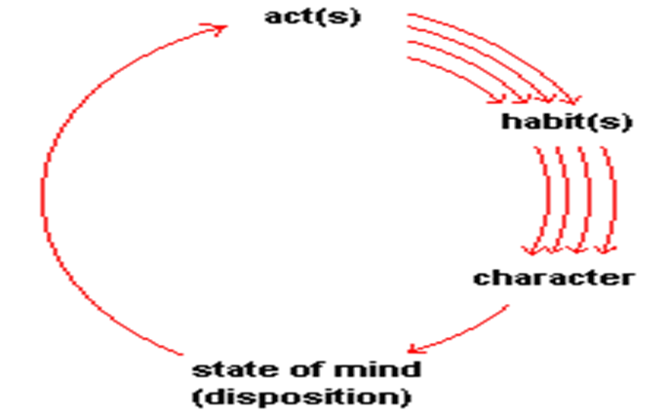
For Aristotle People have a natural capacity for good character, and it also can develop through practice. So, acts, habits, characters and state of mind are fundament traits.
Acts: sequence human behavior, Habits:- are developed through acts personal character. Character:-natural & practical capacity. State of mind:- inherent quality of mind set.

Slide 67
Finally, Aristotle defined Virtue, as arete, or excellence mean b/n two extremes of excess and defect in regard to a feeling or action.
The mean cannot be calculated a priori (most important).
Because the mean is relatively the individual circumstances. For example, consider the following traits:

Slide 68
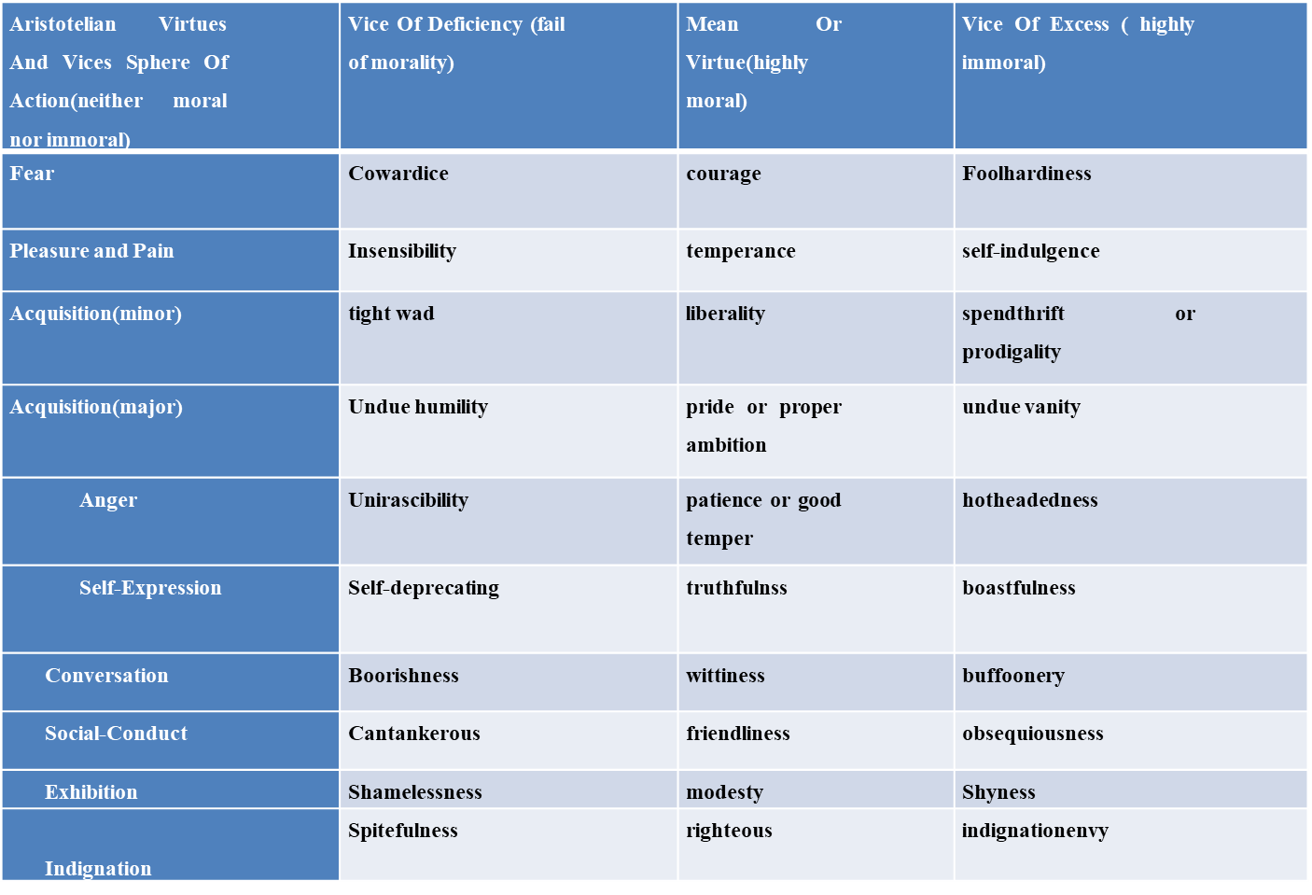

Slide 69
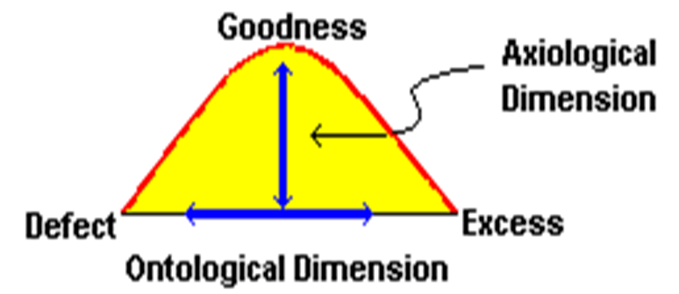
For example Hartmann's Diagram
Ontological dimension:- virtue of ethics reflects mean b/n defect and excess action of ethics
Axiological dimension:- Virtue of ethics promotes moral values, political values and social values that support the action of goodness.

Slide 70
A summary of Aristotle's ethics virtues
For Aristotle Pleasure and pain are powerful determinants of our actions.
The Contemplative Faculty--the exercise of perfect happiness in intellectual or philosophic activity.
Reason is the highest faculty of human beings.
Philosophy is loved as an end-in-itself, and so eudaemonia implies leisure and self-sufficiency as an environment for contemplation.
Eudemonia is the state of personal wellbeing, having self-worth; exhibiting a zest for life; radiating energy; achieving happiness, "good spirit," or self-presence.
happiness is activity of the soul in accordance with areté (excellence or virtue).
Moral Virtue is not the end of life, for it can go with inactivity, misery, and unhappiness but someone being positive by action.

Slide 71
People have a natural capacity for good character, and it is developed through practice. The capacity does not come first it's developed through practice
Virtue, arete, or excellence is defined as a mean between two extremes of excess and defect in regard to a feeling or action as the practically wise person would determine it. The mean cannot be calculated a priori.
Phronesis or practical wisdom: is the ability to see the right thing to do in the circumstances.
Pleasure: is the natural accompaniment of unimpeded activity. Pleasure, as such, is neither good nor bad.
Friendship: a person's relationship to a friend is the same as the relation to oneself. The friend can be thought of as a second self.

Slide 72

Thank You!!

